Slide 1

Becoming a Data Head
Learn to visualize, challenge, and interpret data
Jordan@excel.tv

Slide 2
Dataheads…
Visualize Data
Interpret Data
Challenge Data

Slide 3
Data Visualization

Slide 4
6 | 1 | 2 | 6 | 6 | 9 | 6 | 2 | 2 | 3
3 | 1 | 6 | 1 | 3 | 7 | 5 | 1 | 3 | 5
8 | 2 | 2 | 6 | 7 | 5 | 6 | 1 | 3 | 3
7 | 3 | 6 | 7 | 5 | 7 | 4 | 6 | 7 | 6
5 | 3 | 6 | 5 | 7 | 6 | 1 | 7 | 1 | 6
3 | 9 | 9 | 4 | 7 | 8 | 9 | 8 | 2 | 8
5 | 5 | 3 | 6 | 5 | 2 | 1 | 3 | 8 | 7
6 | 7 | 3 | 1 | 9 | 6 | 2 | 9 | 5 | 7
2 | 8 | 8 | 1 | 3 | 7 | 7 | 6 | 9 | 4

Slide 5
6 | 1 | 2 | 6 | 6 | 9 | 6 | 2 | 2 | 3
3 | 1 | 6 | 1 | 3 | 7 | 5 | 1 | 3 | 5
8 | 2 | 2 | 6 | 7 | 5 | 6 | 1 | 3 | 3
7 | 3 | 6 | 7 | 5 | 7 | 4 | 6 | 7 | 6
5 | 3 | 6 | 5 | 7 | 6 | 1 | 7 | 1 | 6
3 | 9 | 9 | 4 | 7 | 8 | 9 | 8 | 2 | 8
5 | 5 | 3 | 6 | 5 | 2 | 1 | 3 | 8 | 7
6 | 7 | 3 | 1 | 9 | 6 | 2 | 9 | 5 | 7
2 | 8 | 8 | 1 | 3 | 7 | 7 | 6 | 9 | 4

Slide 6
Visual perception is the interpretation of processed information
Notes:
In other words, what we see in the visual world isn’t necessarily what our brain’s interpret. By the time data becomes cognition, it’s already been processed. Visual illusions, for instance, demonstrate how we can create patterns that aren’t there. This is an important concept to embrace: as a computer processes raw data exported by some system, our brains also process information from the visual world.
Data in our world is constantly being processed.

Slide 7
Our brains are built on receiving patterns
We can link information if we follow those patterns
Visualization can help us gain a good understanding of the data.

Slide 8
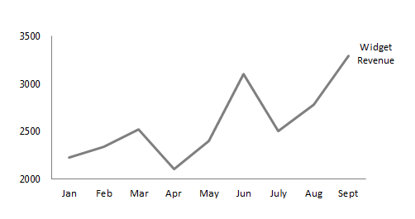
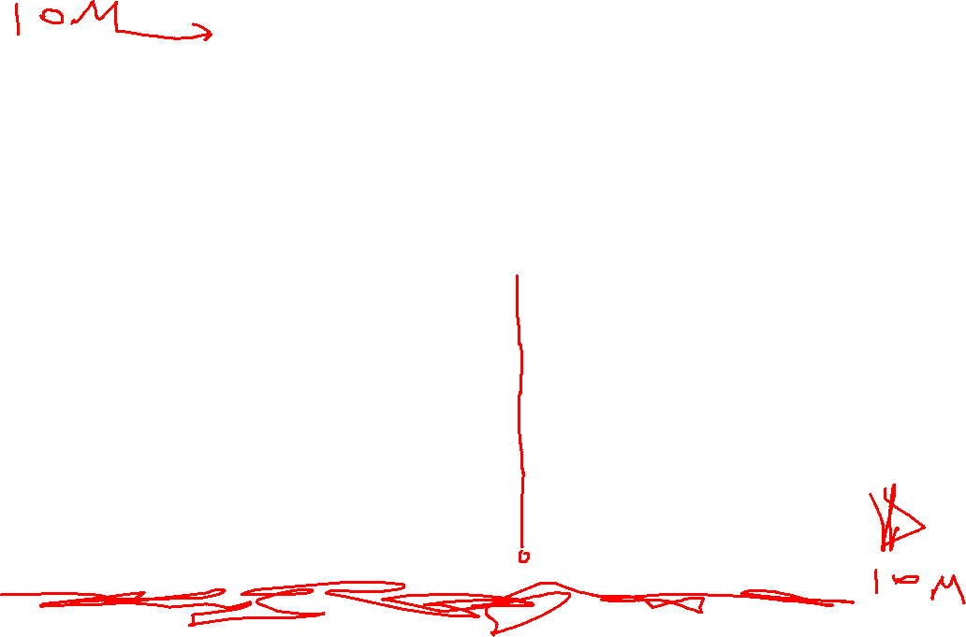
Notes:
Looking at this table, which month had the second highest revenue?
Because there is only a limited number of data items, this is a fairly easy question to answer. But let’s take a moment and focus on the process of answering the question. You probably had to go through each number one-at-a-time and take note of which was greatest. This required you to remember the most recent highest value you just viewed. There was a specific process of committing this information to memory.
We have two types of memory. Working memory and long-term memory. You supplied your working memory with the most recent greatest value as you went through the list of numbers. Once you were finished you recalled where the second highest number was located. Working memory storage is not very large. The most recent research suggests we can hold three-to-seven chunks of information within our working memory for short periods of time.

Slide 9
Visualization concepts
Similarity
Closure
Common Grouping
Continuation
Color Variation
Spatial Position
Notes:
Gestalt laws of grouping are principles of the field of psychology to account for how Humans understand and perceive shapes, objects, and patterns. There are many more laws and categories than listed here. However, I’ve distilled this information down into what you need to know. As we move forward, we’ll see these laws in both theory and practice. Keep in mind how you might incorporate them into your work.

Slide 10

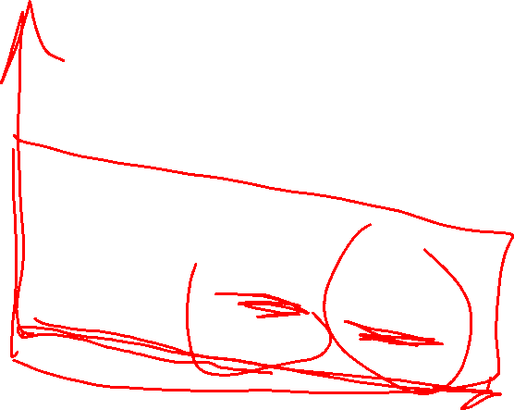
Similarity
Elements which share similar characteristics like shape, color, or size will perceived as being part of a group.

Slide 11

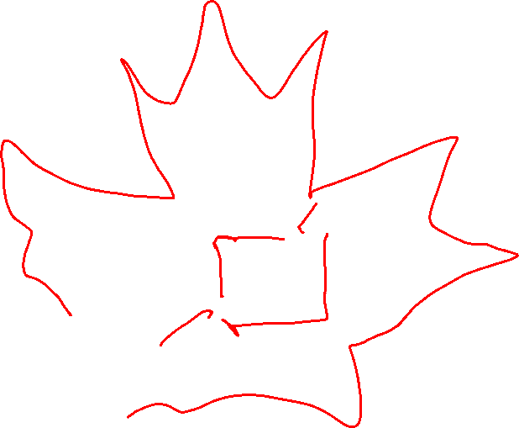
Closure
Closure allows us to perceive shapes, or objects, as complete forms when enough information about an object is already present.

Slide 12

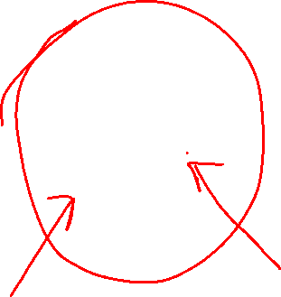
Common Grouping
Common grouping concerns the mind’s ability to perceive connected objects as single, uniform shapes.
Notes:
Continuation refers to our ability to see shapes as being connected. For instance, how many lines do you see in the crosshair above? Most of us will say that we two lines crisscrossing. Some contrarians might say they see four lines meeting at the center point. However, few people will say they see a series of tiny lines connected together to give us the illusion of larger line segments. That’s because we perceive connected objects as uniform shapes.

Slide 13

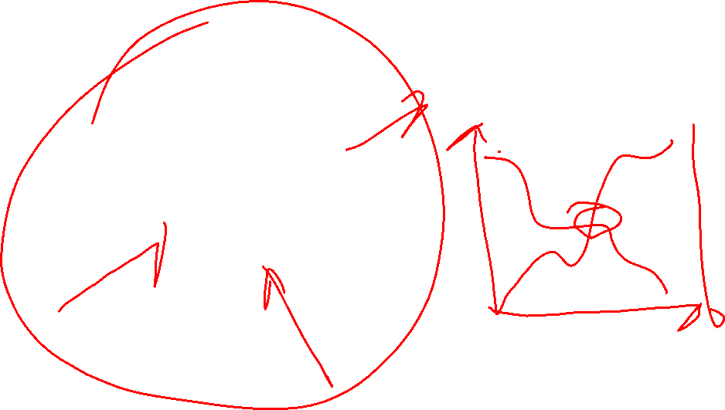
Continuation
Continuation allows our minds to perceive continuation of overlapping shapes and forms as being uninterrupted.

Slide 14
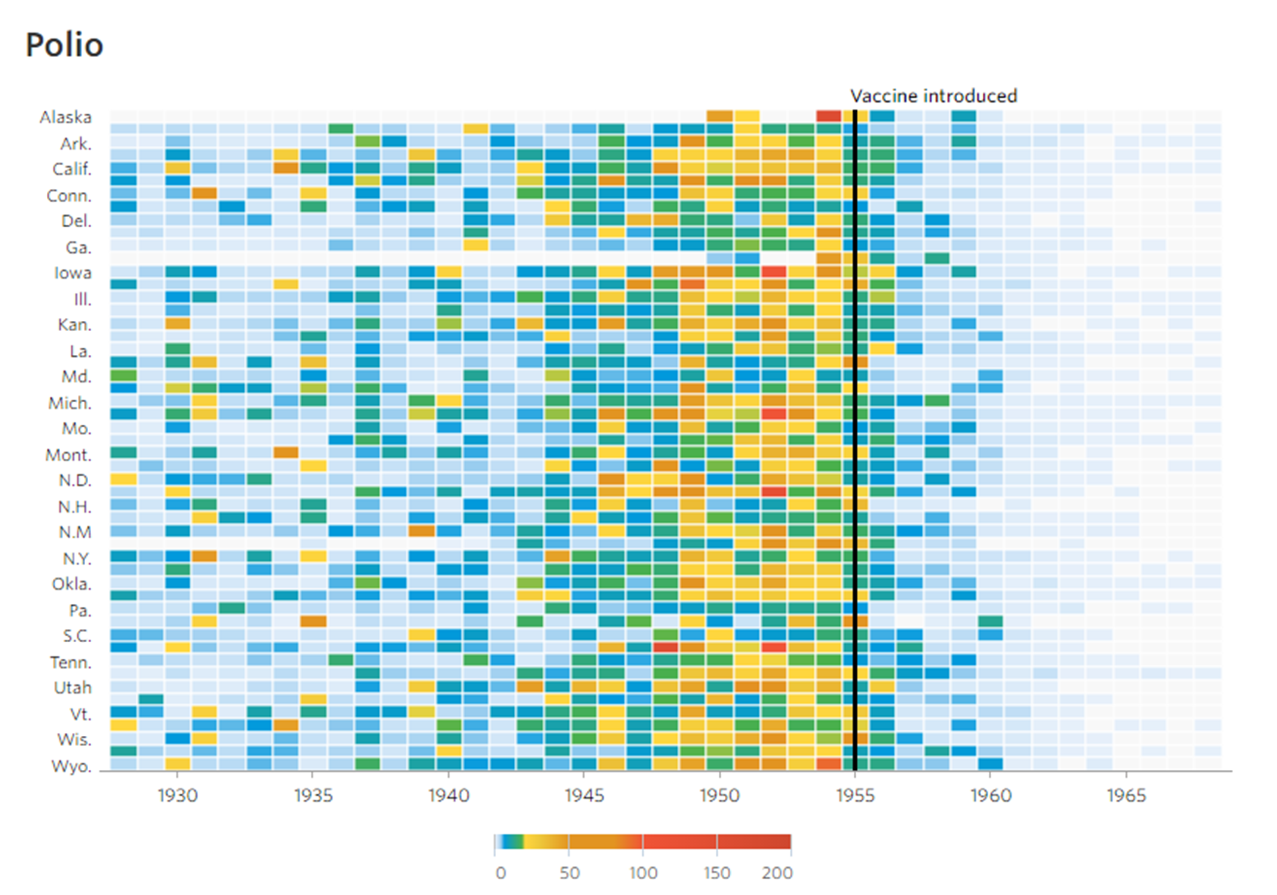
ColoR variation
Color variation (hue, intensity, contrats, etc.) allows us to encode relative variation in data.
Notes:
Hue and intensity can create qualitative distinctions in quantitative values. Hue can be useful to signify which projects may be high risk, as in the chart below. The project with the darker hue signifies that it has a higher associated risk than the other projects being evaluated.

Slide 15

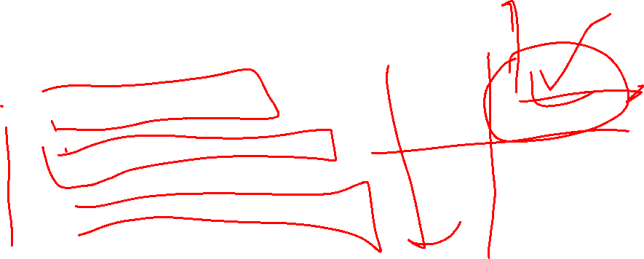
Spatial Position
Values are judged to be greater when they are higher up or farther to the right.
Notes:
Spatial positioning is a preattentive attribute with which we are most familiar. It suggests that we judge values to be greater when they are higher up and farther to the right. This makes intuitive sense based on what we’ve learned in algebra. In fact, you can see how our mind inputs missing data to make this work on the next slide.

Slide 16
Let’s talk about pie charts…

Slide 17
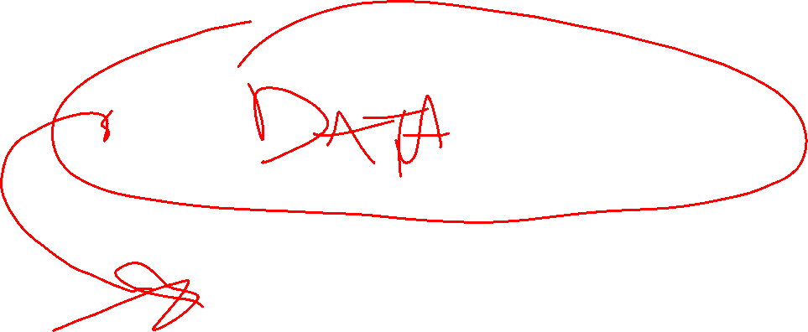
Which Slice is Largest?

Slide 18
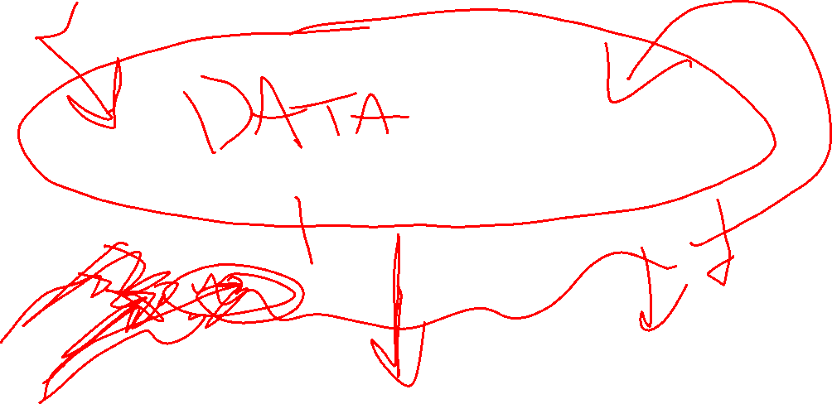
Which Slice is Largest?

Slide 19
Which Slice is Largest?
Notes:
Both the Yes and No slices are indeed the same size. However, by using a three dimensional perspective we create information that isn’t there. In other words, our brain has created quantities that don’t actually match the underlying data. This is a big problem in organizations, where embellishments and three dimensions are employed to make charts more interesting. However, there is an unintended consequence of delivering an incorrect message.
More than that, this exercise should affirm a very salient fact about data visualization. We don’t always interpret data correctly. Recall that I said data analysis is actually more subjective than we think. This should demonstrate how easy it is to disconnect underlying data from reality. A simple way of viewing the data created something incorrect in our minds.

Slide 20

What is the percentage value of each slice?
Notes:
Take a look at the pie chart in this slide. If you were try to evaluate the amount of each slice, you would have to use the sides of each wedge as a baseline. This makes the baseline radial as you move around each wedge to judge its value. On the other hand, column and bar charts have a “common baseline” that extends across all different categories.
There are two questions posed by this chart: (1) Which slice is greatest?; and (2) What’s the percentage value of each slice?
Neither of these questions is very easily answered. We could speculate that Crackers, Hot Dogs, Tator Tots, Grilled Cheese, and Tacos are all about the same value, and we’d probably be right. But what if we tried to put them an order? This would be no easy task.

Slide 21
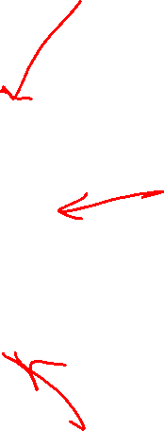
Notes:
Take a look at the pie chart in this slide. If you were try to evaluate the amount of each slice, you would have to use the sides of each wedge as a baseline. This makes the baseline radial as you move around each wedge to judge its value. On the other hand, column and bar charts have a “common baseline” that extends across all different categories.
There are two questions posed by this chart: (1) Which slice is greatest?; and (2) What’s the percentage value of each slice?
Neither of these questions is very easily answered. We could speculate that Crackers, Hot Dogs, Tator Tots, Grilled Cheese, and Tacos are all about the same value, and we’d probably be right. But what if we tried to put them an order? This would be no easy task.

Slide 22
Notes:
Take a look at the pie chart in this slide. If you were try to evaluate the amount of each slice, you would have to use the sides of each wedge as a baseline. This makes the baseline radial as you move around each wedge to judge its value. On the other hand, column and bar charts have a “common baseline” that extends across all different categories.
There are two questions posed by this chart: (1) Which slice is greatest?; and (2) What’s the percentage value of each slice?
Neither of these questions is very easily answered. We could speculate that Crackers, Hot Dogs, Tator Tots, Grilled Cheese, and Tacos are all about the same value, and we’d probably be right. But what if we tried to put them an order? This would be no easy task.

Slide 23
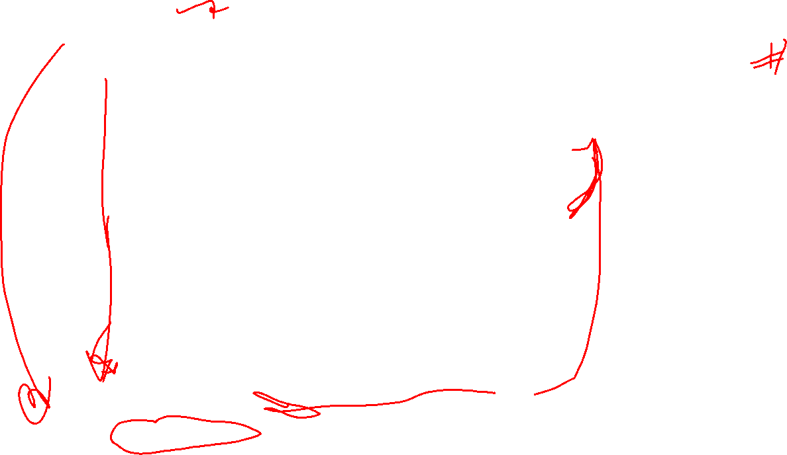
Notes:
If we go back to our preattentive attributes, we see spatial positioning does a much better job in conveying the underlying details. Here we are able to establish a rank order and can more clearly see the differences between each group. We could even add another axis with percentages that would give us proportion-to-the-whole information.

Slide 24
When should you use a pie chart?
Notes:
I’m (mostly) joking about this. But, if nothing else, you should consider your own tendency to default to using pie charts (if that’s what you tend to do). Consider using a bar or column chart instead and then compare your results to the pie chart.
Ask yourself:
Which one does a better job representing the underlying data?
Which does a better job helping you stay informed or make a decision?
Rather than evaluate your work based on the rules of data visualization, you should evaluate your work based on the value it provides in a given situation. Using the previous questions, even I have to concede pie charts can work in some situations.

Slide 25
OK but…

Slide 26
Your manager won’t listen.
You don’t have enough time (or knowledge) to create the perfect chart.
You don’t necessarily agree.
What about infographics?
Do they really need to follow data visualization rules?
Notes:
After doing this talk for so many years, I’ve learned the rules presented, while important, don’t always translate in practice. For one, even an imperfect data visualization might be much more valuable than nothing. More than that, some analysts struggle with creating the perfect data visualization or chart.
In other words, we need to ground the previous rules in practice. It’s not as important to be perfect, rather we should understand when following data visualization principles is key and when departing from them is OK too.

Slide 27
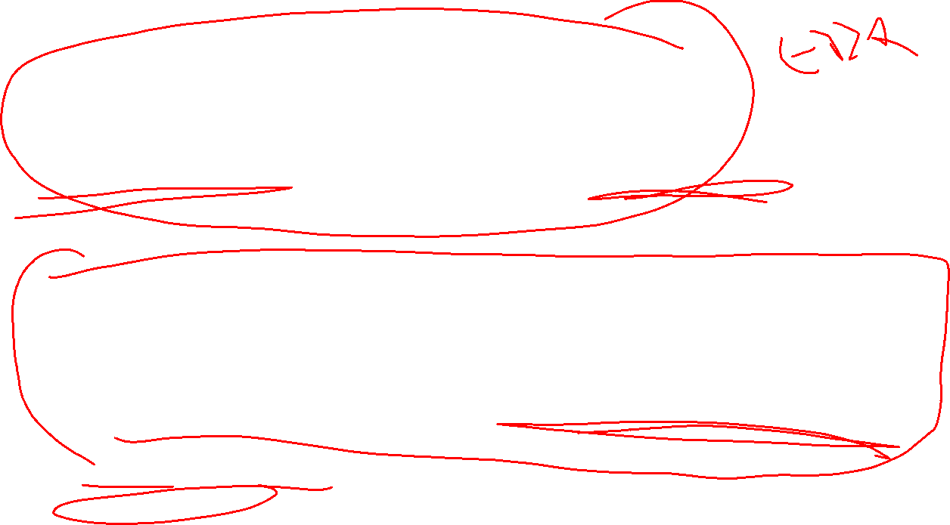
Data graphics are for when we are investigating data, looking to uncover some story.
Infographics are for when we already have the story but we want graphics to support the message.
Notes:
While the data visualization rules have set out certain standards, the reality of the business world is that these types of charts are often too stiff or business-like for public reports and messaging. Here, we’ll make a distinction between two types of graphics.
Data graphics
Data graphics are those that more closely align to the rules we mentioned previously. These types of graphics are used for investigating the data and looking for insights. In other words, we might not actually know what the data say. So we use data graphics for things like exploration and investigation, and to report our results internally.
Infographics
On the other hand, infographics are more colorful and less structured, much to the dismay of many data visualization gurus. Yet, I’ve found they have their place in material that goes out to the public, to leadership, or is used for marketing purposes.
The main difference between these two types is when the data narrative is formed. Business graphics are used when we don’t know what we’re looking for, when we must report our work to subject matter experts, and when we’re explaining our work to technical people like at conferences or in academia. For infographics, the narrative already exists. For instance, a non profit might provide a report at the end of the year. They might use infographics to enhance the narrative that already exists. In other words, data graphics are used to help make decisions; infographics are used when the decision has already been made.

Slide 28
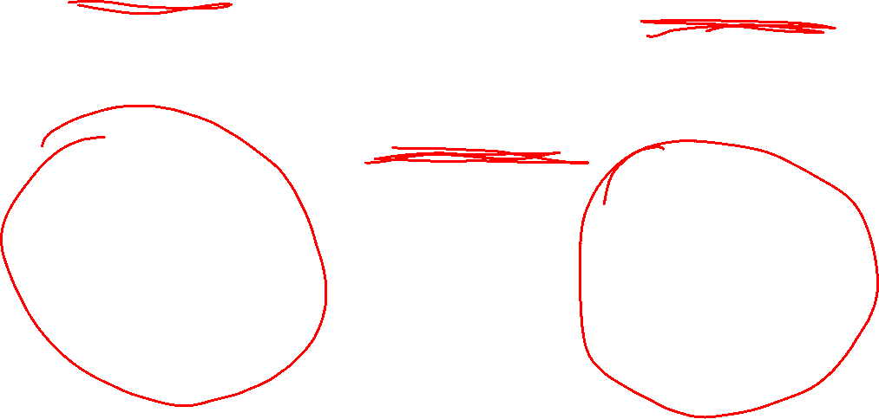
Less Complex
More Complex
Infographics
Data Graphics
High-Level Audience
Subject Matter Experts
Leadership
Management
Shareholders
Stakeholders
Clients
Coworkers and technical managers
Colleagues
Technical stakeholders
Academic conferences
Notes:
Infographics are often less complex because they go to a high-level audience which includes leadership and the public. Data graphics are often more complex, and their audiences include internal folks and technical colleagues.

Slide 29
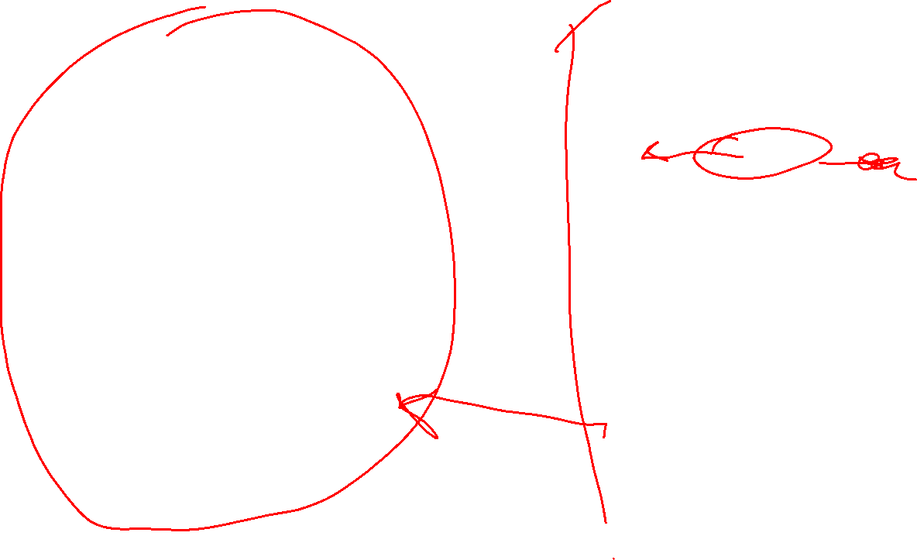
Less Complex
More Complex
Infographics
Data Graphics
Analysis is complete.
Charts support a preexisting narrative.
Exploratory Analysis
Charts used to help identify results.
High-Level Audience
Subject Matter Experts
Notes:
In many ways, we can think of the differences between the two as being on a continuum. At the far left are infographics which don’t necessarily follow all data visualization rules. To the far right are have data graphics which are for more technical audiences. Again, the difference between the two is about when the narrative is formed. To more the left we go, the more the analysis has been completed; the more the right, the more work the analyst still must do (or has done) to create the underlying narrative.
All of this raises the question about what to use when….

Slide 30
PRINCIPLE #1 What we present must always be the natural extension of the underlying problem.
Notes:
The answer isn’t so simple, but it can be reduced to a simple axiom: what we present must always be the natural extension of the underlying problem. By natural extension, we mean that the visualization used does not overstate results, deceive the viewer, and fully and comprehensively represents the underlying problem. Take a moment and consider the data visualization principles we presented previously. In many cases, the addition of the third dimension violated this principle.
We’ll delve back into this subject later near the end of the course.

Slide 31
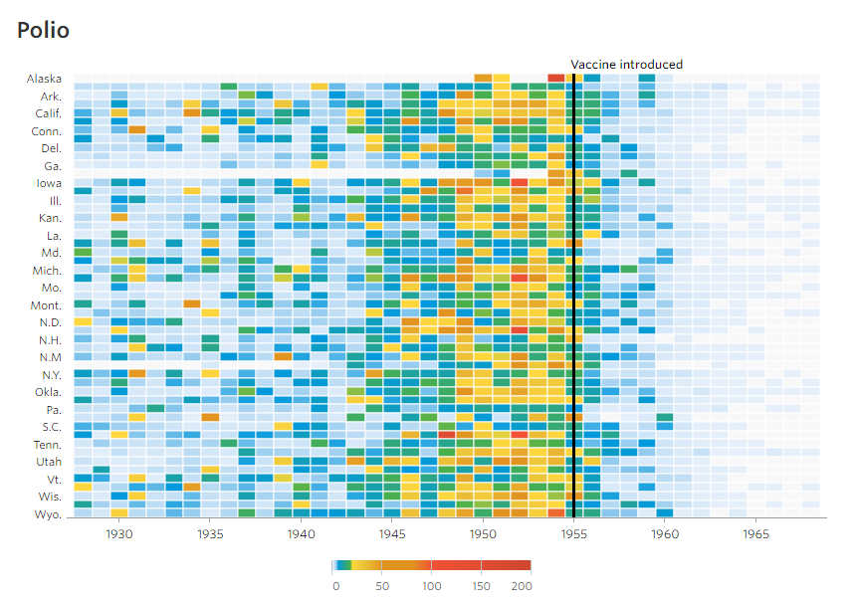
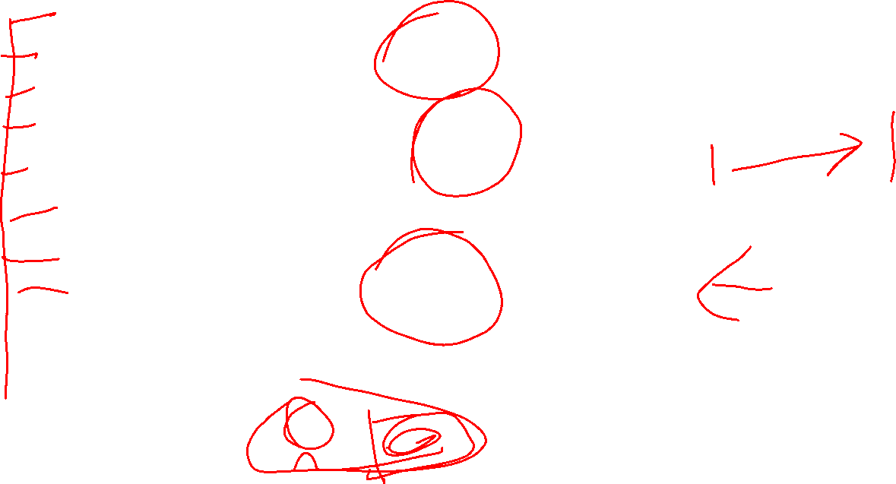
Battling Infectious Diseases in the 20th Century: The Impact of Vaccines, Wall Street Journal
Notes:
This chart appeared in the Wall Street Journal and reflects incidences of polio for the vaccine was introduced. We can see state by state information of incidences. After the vaccine was introduced we see the incidences decline.
Let’s compare this chart to the next chart.

Slide 32
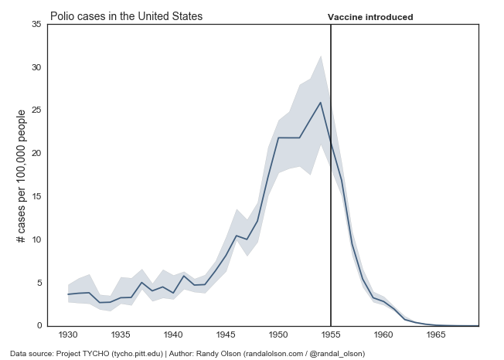
Revisiting the vaccine visualisations, Royal Statistical Society
Notes:
The Royal Statistical Society decided to revisit the previous chart. Their point was that state-by-state information was not necessary to evaluate the problem.
Take a few minutes with each chart and write down what you think the advantages to each chart is. Then we’ll go over some of my own thoughts.

Slide 33
¯\_(ツ)_/¯
Notes:
The answer isn’t so simple, but it can be reduced to a simple axiom: what we present must always be the natural extension of the underlying problem. By natural extension, we mean that the visualization used does not overstate results, deceive the viewer, and fully and comprehensively represents the underlying problem. Take a moment and consider the data visualization principles we presented previously. In many cases, the addition of the third dimension violated this principle.
We’ll delve back into this subject later near the end of the course.

Slide 34
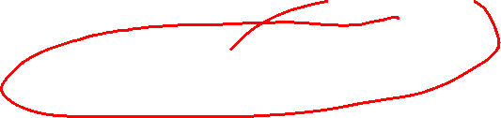
Complexity Required to Present the Problem Correctly
Business Analysts
Data Scientists
More Simple
More Complex 
Bias
Self-Indulgence
“Explain it to your manager like he is in the second grade.”
“The WSJ story shows the impact of vaccinations equally well, with the added advantage of displaying as much of the data as possible.”
Andy Cotgreave
Notes:
One problem that arises through all of this is when we use the wrong types of graphics to present our work. Indeed, confusion results when we choose data visualisations that are too simple or too complex.
In this chart, we’re going back to the spectrum introduced previously, that more simple infographics or aimed at business analysts where more complex work is aimed at data scientist.
Sometimes, however, some problems are forced to be presented one way over the other. Let’s put data visualization into the context of the previous examples. For instance, we’ve established that infographics are useful for when the narrative has already been established. But what happens when we use a simple chart to represent a complex idea? The result is often confusion. Indeed, just as we need to talk about data correctly, we need to ensure what we present is the natural extension of the underlying problem. As previous examples have shown, it’s not always that simple.

Slide 35
Principle #2 Visual complexity often results when we don’t know our audience.

Slide 36
Principle #3 Over simplification often results when we don’t trust our audience.

Slide 37
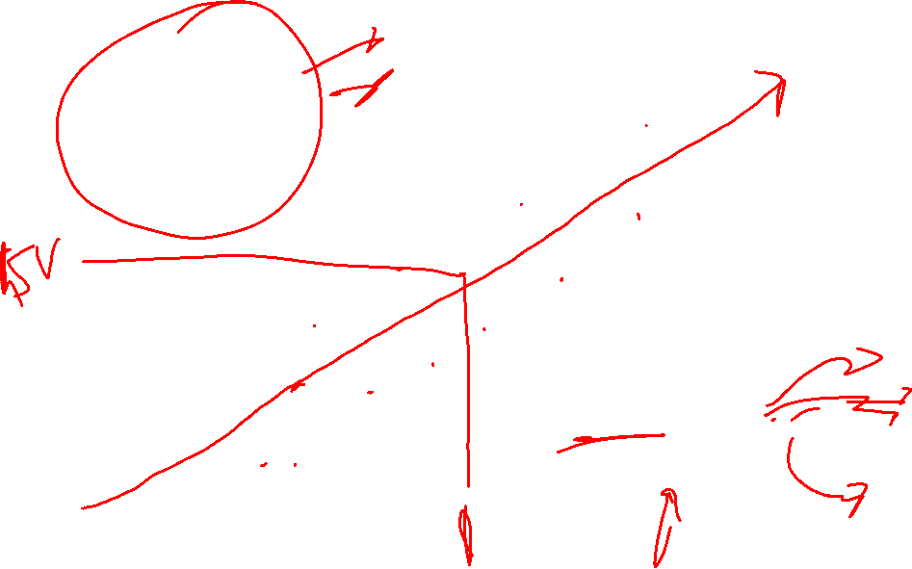
The natural extension of the underlying problem.
Complexity of the presentation.
High visual complexity, low problem complexity
Confusing message
Overly-detailed
Often very colorful
Understood by only a few
Does not delivery on its
Promise
Salesy
High problem complexity, low visual complexity
Results from arrogance
Confirmation Bias
Politically motivated
Obscures important details
Created to support a belief, not to inform
Underlying problem complexity
Notes:
Here’s a good rule of thumb that follows from the previous rule. Underlying visual complexity should match one-for-one to the complexity of the presentation. When they don’t, confusion and oversimplification ensue. Take a look at this chart to understand. Presentations with high problem complexity but low visual complexity often mask some underlying message. Presentations with high visual complexity but low problem complexity result in a very confusing message. Some associated reasons for each are given. Either way, in both extremes, the presentation is disconnected from the underlying problem.

Slide 38
Principle #4
Proper data visualization is about trade-offs.
Sometimes one seemingly correct choice hurts you in another way.

Slide 39
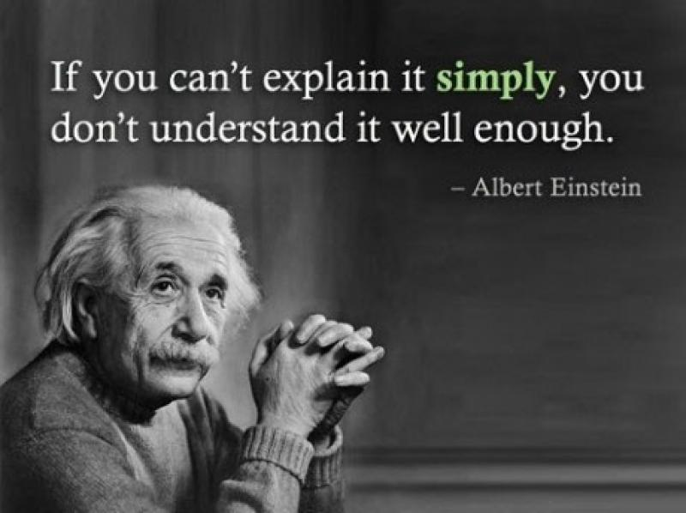
But what about Einstein?
Notes:
I hear you: what about Einstein? Didn’t Einstein push for simplicity? What about Keep It Simple, Stupid (KISS)? What about explaining things to leadership like they’re fifth graders?

Slide 40
By introducing sophisticated mathematical concepts like this into physics, Einstein …abandoned the popular principal attributed to [Lord] Rutherford [of Nelson] that ‘an alleged scientific discovery has no merit unless it can be explained to a barmaid….’”
Einstein, the Man and His Achievement By G. J. Whitrow, Dover Press 1973
Notes:
Well, as it turns out, Einstein probably didn’t say this, and if you’ve ever looked at any of Einstein’s research, it’s unclear he even really believed it. This is just another example of how cultural myths and platitudes creep into our work without any sort of challenge on our part.

Slide 41
Principle #5
Respect your audience!

Slide 42
Provide people the level of detail they desire and not what you think they need.
Don’t assume because someone is above or below you in the chain of command that they aren’t as smart as you.
Have confidence in what you present and don’t downplay your own strengths.
Notes:
You could attempt to memorize the rules I’ve given you previously, but I think it’s much easier to respect your audience and yourself. If you respect your audience and have confidence in your own (even in this face of being challenged or wrong), much of these visual complexity issues go away.

Slide 43


Statistical Thinking
We’ll go over:
Models
Noise
What statistics is designed to do (at a very high-level).
How to talk about statistical models.
What confidence and statistical significance means in practice.
Notes:
In this section we’ll discuss the importance of what I like to call statistical thinking. To the extent possible, I’ve tried to eliminate equations and extra math. Instead, I want you to consider what we’re trying to achieve when we use statistics. So many analysts (and even trained statisticians) understand statistics in a very mechanical sense. But I want to do here is go outside the conversation (as we did in the opening of this course).
Going forward, we’ll review a few key statistical terms. Next, we’ll place them into context of a real-world example. Most important, we’ll focus on their value. Through this, you will gain the confidence to be able to talk about the concepts at work and to be able to evaluate media that uses them.

Slide 44
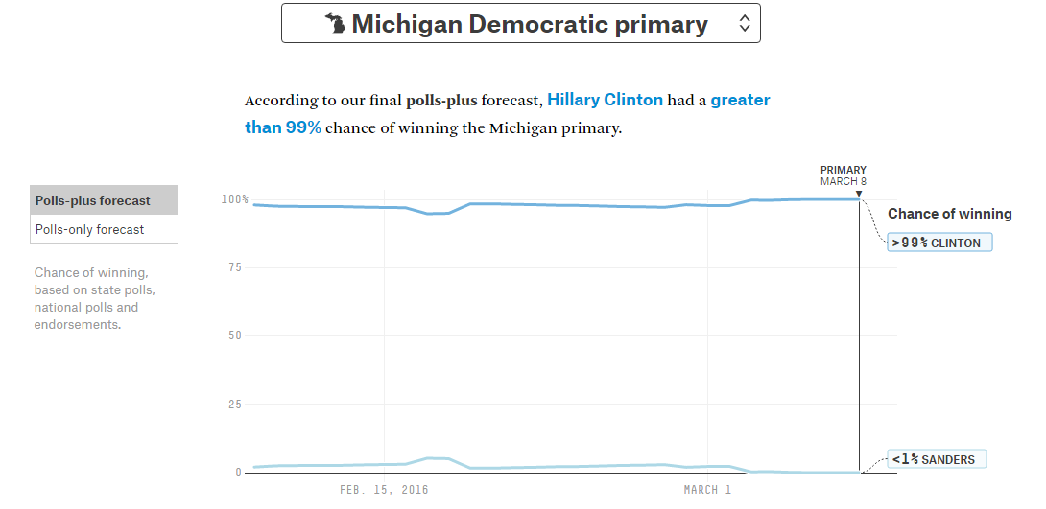
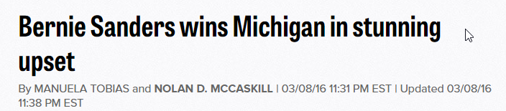
Notes:
Remember, Nate Silver’s model gave Hillary Clinton a greater-than 99% chance of winning the Michigan primary. However, once all the votes were counted, Bernie Sanders beat Clinton.

Slide 45
Let’s understand how the model worked.
The model collects recent polling and demographic data.
Polls are weighted on how well they’ve predicted previous elections.
These polls are applied to a model that creates random election outcomes.
A simulation based on these outcomes is ran 10,000 times.
In this case, Hillary Clinton won roughly 99,000 times and Sanders1,000 times.

Slide 46

What went wrong?
“The model did not account for the improbable.”
“A good model is bound to be wrong every once in a while. It was 99 percent confident, that means there was a 1 percent chance it could be wrong.”
“If there was more uncertainty about the results, the model should have shown less confidence.”
Notes:
In these next few slides, we’ll discuss the conversations about the model itself. After the model failed to account for a Sanders win, several commentators discussed why that might happen. At the same time, the public attempted to both critique and support the model with various arguments.
Many of these arguments highlight misunderstandings in statistics. I’ve picked a few that I’ve liked because I think they will bring the concepts we’ve discussed so far into context.

Slide 47
Accounting for the improbable.
Philosophical question: was a Sanders’ win an improbable event?
If we accept a Sanders win as improbable, then there’s not anything wrong with the model itself. The model gave sanders a remote chance of victory. That means it accounted for the improbable.
If you believe the event was more likely, then the model had incorrect assumptions or did not capture some salient underlying relationship.
Notes:
Many people have contradicted themselves in critiquing the model for failing to account for what they believe was an improbable event. The problem of course is that the model did account for the improbable by giving Sanders a small chance of winning. It may just be the improbable has taken place.
Either way, we must decide how to look at that event.

Slide 48
“There was a 1% chance it could be wrong.”
Again, was the model wrong?
The model gave Clinton 99:1 odds-to-win. Those odds refer to outcomes, they don’t refer to the model’s validity.
This is a common misconception. The odds-to-win are called the odds ratio. They measure the probability of an outcome. The chance of being wrong is a measure of confidence.

Slide 49
“The model should have been more specific about the chance of being wrong.”
So, how do we test the likelihood a model is wrong?
We don’t!

Slide 50

All models are wrong!
Notes:
Models do not quantify the chance they are wrong. If we are using a model, we assume we’ve done a good job at capturing some real underlying relationship. If a model is “wrong,” it’s not necessarily because it failed to account for an improbable event. What makes a model wrong is that it fails to capture the underlying relationship. When it does this, then the model itself is using faulty assumptions upon which to make predictions.
Remember: all models are wrong, some are useful.
Indeed we don’t really have a test for the probability a model is wrong. However, there is a test statisticians employ to gauge how reliable a model is. You may have heard of this metric. We often refer to it as “model confidence.”

Slide 51
Model Confidence
Confidence measures the chance of noise creeping into the model. The industry standard for model confidence is 95%.
What does it mean to be 95% confident?
Notes:
Remember, confidence doesn’t test the likelihood a model is wrong or invalid. We assume if we’re using a model that it’s valid (at least for our purposes). Instead, when we’re talking about confidence, we need to go back to the concept of noise.
Confidence measures the chance of noise creeping into the model which may manifest upon repeated tests.

Slide 52
Confidence is a test of universal reliability.
Let’s say we run Nate Silver’s algorithm across twenty states. Let’s say it accurately predicts 17 of these states.
1
2
3
4
5
6
7
8
9
10
11
12
13
14
15
16
17
18
19
20
Confidence says nothing about prediction accuracy. Instead it gauges the likelihood any result is accidental. At 95% confidence, we accept that 1/20 (5%) of tests we run will appear like true data but may actually be random.
Notes:
Confidence says nothing about prediction accuracy.
Read that above sentence and then read it again and again. And then maybe one more time. Confidence says nothing about prediction accuracy. Confidence is different than odds. If Clinton had a 99% chance of winning according to the model, that may have still been at 95% confidence.
Confidence instead deals with the possibility that the model results are more than randomness. For instance, the eighth time the test is run in our example, it fails to predict the winner correctly. This failure to predict is still a real result of the model. That the model failed to predict might be because it hasn’t fully captured the underlying relationship we find in the real world. But this fact is not directly tied to confidence.
Confidence is testing the likelihood of any result being mere accident.

Slide 53
Let’s say the test is 100% accurate in all of its predictions.
1
2
3
4
5
6
7
8
9
10
11
12
13
14
15
16
17
18
19
20
At 95% confidence, we accept at least one of these results is dumb luck.
Accept is the operative word. We don’t really know which of these runs is the result of noise but we accept it can happen about 5% of the time.
In other words, we believe it’s at least reliable 95% of the time. We accept the other 5% might just be randomness.
Notes:
Let’s say the test is 100% accurate in predictions. 95% confidence then says that one of these twenty tests on average could have predicted correctly by sheer dumb luck. We don’t know which test it is, and to a certain extent we don’t care.
We can really think of confidence as a threshold. Since we know noise exists in the world, and we accept that noise can look like a real result, it makes sense to set a threshold against which we can accept a certain level of noise to exist in our data. This noise can creep through our models and make it look like a real result. However, confidence allows us to be fairly confident that most of the time, we’re capturing something real and not just something that looks real.

Slide 54

Why not make all models 99% confident?
To do that well, we need lots of good data!
A certain amount of data is required to get to the 95% confidence level. When we have enough data to accept 95% confidence, the results are said to be statistically significant at that level.
To be statistically significant at the 99% confidence, we’ll need much more good data!
Notes:
But then this raises the obvious, why stop at 95% confidence? The answer has to do with the concept of statistical significance. We’ll bypass the mathematical theory here and go straight to the point. To be more confident, we need more data. Since its impossible to capture all the data in the universe, we need to setup rules for how much data is required for us to be confident we’ve captured something real and not just noise.
This is why statisticians say that a model is statistically significant at a specific confidence level.

Slide 55

Statistical Significance
Statistical significance simply means we have set a tolerable threshold against which we can feel confident our results aren’t completely random.
When polling results say they are statistically significant at 95% confidence, that means if they ran that test 100 times, they are OK with 5 of these tests being the result of randomness.
Notes:
This is actually the same practice as before. If we feel confident we’ve explained some underlying interaction, then all that’s leftover is noise! Confidence helps us establish a baseline of how much noise we can tolerate.

Slide 56
It’s OK to be confused by all of this.
“The p-value was never intended to be a substitute for scientific reasoning,” said Ron Wasserstein, the ASA’s executive director.
“Well-reasoned statistical arguments contain much more than the value of a single number and whether that number exceeds an arbitrary threshold. The ASA statement is intended to steer research into a 'post p<0.05 era.’”
Notes:
Perhaps you understand this concepts in practice but are still a little confused by them. That’s alright, because so are the world’s leading statisticians! Recently, the American Statistical Association released its guidance on the use of confidence intervals. It found that researchers would hack at their data until they could achieve a level of 95% confidence. What this has created is a corpus or irreproducible scientific work.
Remember, if you torture data, it will confess!
I’m not saying you shouldn’t use confidence—far from it! But I agree with the ASA on this point that’s worth reiteration: Well-reasoned statistical arguments contain much more than the value of a single number and whether that number exceeds an arbitrary threshold.
Hopefully, based on what you’ve learned so far, you see statistical thinking as something that happens holistically. It’s not simply about the numbers. There’s a fair amount of critical reasoning involved of which charts, numbers, stats, experience, intuition, and expertise is a part.

Slide 57

Biases

Slide 58

Confirmation Bias
Perhaps the easiest to identify in others, hardest to identify in ourselves.
We can challenge confirmation bias by gauging the extent to which we believe the data outright.
Notes:
Confirmation bias is incredibly easy to identify in others and terrible hard to see in ourselves. There are a few ways to stem its effects:
First, we can outline what we believe going in. If nothing else, this sets up that we have a predisposition. It’s very easy when performing the analysis to think the idea came as a result of the analysis. Let’s not deceive ourselves. If we’re clear about what we believe beforehand, we can at least test the results against our expectations. Additionally, we can outline exactly why we believe what we believe beforehand.
Finally, sometimes it just helps to ask someone with a fresh set of eyes. Often they will consider things we hadn’t.

Slide 59

Resource Bias
We’re far less likely to turn our backs on models we’ve invested a lot of time, money, and resources in.
We’re less likely to tell people our results our wrong, even if we abandon them!
We’re even less likely to believe someone who tells us their results are wrong!
Notes:
The resources bias is hard to stem because sometimes pouring resources into our work is unavoidable. The fact is, it’s hard to turn our backs on something we’ve put a lot of time, money, and effort into. Often we want to make it work to the bitter end, and perhaps there’s something admirable about that. But that reality is that we need to be aware of red flags early on and not simply hope in time they will be mitigated.
What makes the resources bias particularly pernicious is how it affects our work culture. Even if we inevitably realize the thing we’ve worked on for months is wrong, we’re less likely to admit to it. When we abandon projects we may say something like, “well it’s on hold for now,” or, “we’ve found something better.” These statements may even be correct, but they lack accountability. We fear by admitting defeat people won’t trust us. Just as we don’t often put our faith in people whose models fail to predict an accurate result, we fear the same for our ourselves and our work. This causes us to move on from failed data projects without a requisite post-mortem. We don’t take the time to understand what worked, what didn’t, and why.
One way around the resource bias is simply holding back. The promise of big and better technology might motivate us to pull the trigger on a big expensive platform. But sometimes we can get by, by prototyping things in Excel or R. Both of these are cheap or free, and they can do what the big platforms can do, perhaps on a smaller scale and with more work, but they may at least prove out the model long before your organization invests its resources behind it.

Slide 60
What can we do?
Build your work in Microsoft Excel, R, Web Technologies, etc. Use cheap and free resources.
Choose an open source platform that does not require you or your company to carry the burden of time, resources, and investment.
Develop a long term relationship with a vendor that is interested in results.
Notes:
Focus on that second bullet for a moment. By using Open Source and cheaper platforms, we don’t reinvent wheel. In addition, there are huge communities of likeminded developers and IT managers who likely have dealt with the same issues you have. Their knowledge is almost always free and everyone is happy to give it. So before going at it alone, look to these online communities and let them shoulder the burden of some of the project work.
If we’re being realistic, we’ll need some type of data platform to compete in today’s market. There are a lot of platforms that can do amazing things. But instead of looking for functionality from a given platform, you need to look for a relationship. You don’t want to be the person asking the vendor for feature x and y, have them charge you for it, and then watch as they turn around to sell the same feature to others. You need a longstanding partnership where both you and the vendor are focused on returning value to the business. Yes, it’s important to consider “magic quadrant” products that are new, promising, and filled with features but don’t forget your vendor liaison is the person you’ll be working with most immediately. Your relationship with them—and to an extent their company culture—is just as important as features and price.

Slide 61

Missing Information Bias
Bad data is usually created because no information exists.
The belief all group samples can be extrapolated.
Notes:
Sometimes we don’t have clean data. Bad data is all we have to work with. In these instances, we might use the bad data as is or even change some of it to reflect what the data should be. There’s nothing wrong with this necessarily, but it can also land us in all sorts of trouble. In addition, we often believe that a small amount of good data is enough to form a representative sample upon which to extrapolate results. For instance, a few months of positive financial data does not necessarily mean the trend will continue, even if it fits nicely to a line. Remember, results are always the product of assumptions, noise, and bias. Missing data doesn’t mean you can’t say anything, it just means you need to be very specific about such claims and be open to future revisions.

Slide 62
What can we do?
Use statistical methods to interpolate missing data.
Research and understand underlying biases inherent in the data.
Add context to results.
Notes:
If you have bad data, the good news is that there are lots of statistical methods to help out. Sometimes it’s as easy as replacing the missing data with an average. Other times, this isn’t such a good idea! The point remains however there’s lots of research on what to do with certain types of data. At least consult the research before pushing ahead.
You might also take the additional step to understand why some data is missing. Are people not reporting data they ought to be reporting? It’s possible the dataset sent your way has some bias baked in. Go invest some time with stakeholders and the data supplier to see what assumptions they have about the data.
It’s worth repeating here: but everything can be “correct” when placed into context. Make sure you clearly communicate the context in which your results were produced and data were supplied.

Slide 63
How to avoid being misled.
Learn to be skeptical of results.
Use technologies that don’t require significant amounts of planning and resources.
Learn some data science.
Learn some data visualization.
Place all work, advice, etc in context.

Slide 64
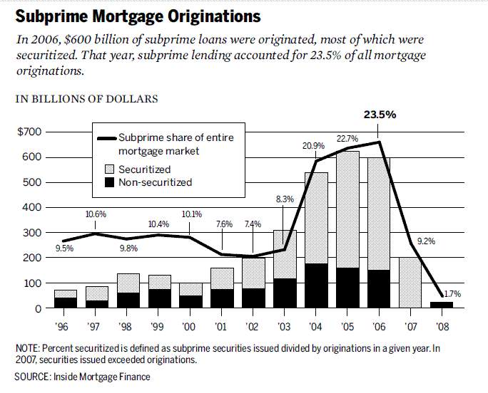
By National Commission on the Causes of the Financial and Economic Crisis in the United States - Final Report of the National Commission on the Causes of the Financial and Economic Crisis in the United States, p.70 figure 5.2, Public Domain, https://commons.wikimedia.org/w/index.php?curid=26535418
Notes:
Let’s take a moment and consider the housing market crises, arguably the largest data disaster of recent memory. Do any of these previous conversations actually address this data disaster:
Was the problem that “IT” did not talk to business side?
Was it because they hadn’t yet implemented self-service analytics?
Was it because they hadn’t learned statistics, data visualization, or computer science?
Was it a concern about privacy or data security?
No, the errors in this case were committed by experts with some of the best technology available. These errors were committed by people who probably should have known better. So let’s take a moment and reapply this discussion into our own business world.

Slide 65
Go Be a Data Head!
Download my slides: excel.tv/atd2020

